Slide 1
MENTORNESS INTERNSHIP PROGRAM
PROJECT 2 : HOTEL RESERVATION ANALYSIS USING SQL
BY – RAHUL PRASAD
BATCH - MIP-DA-10

Slide 2
PROJECT OBJECTIVE : Analyzing a hotel reservation dataset using SQL
Extracting insights into guests preferences , booking trends and operational factors.
Provide actionable recommendations to improve guest experiences and optimize hotel operations based on data driven findings .

Slide 3
DATASET
The dataset includes the following columns:
Booking: A unique identifier for each hotel reservation.
No of adults: The number of adults in the reservation.
No of children: The number of children in the reservation.
No of weekend nights: The number of nights in the reservation that fall on weekends.
No of week nights: The number of nights in the reservation that fall on weekdays.
Type of meal plan: The meal plan chosen by the guests.
Room type reserved: The type of room reserved by the guests.
Lead time: The number of days between booking and arrival.
Arrival date: The date of arrival.
Market segment type: The market segment to which the reservation belongs.
Avg price per room: The average price per room in the reservation.
Booking status: The status of the booking.

Slide 4
Query:
SELECT COUNT(*)
FROM hotel;
Result: Total reservations in the dataset: 700
1-What is the total number of reservations in the dataset?
Query:
SELECT type_of_meal_plan, COUNT(type_of_meal_plan) as most_ordered_meal
FROM hotel
GROUP BY type_of_meal_plan
ORDER BY most_ordered_meal DESC;
Result: The most popular meal plan among guests is: Meal Plan 1 WITH 527 ORDERES
2-Which meal plan is the most popular among guests?

Slide 5
Query:
SELECT AVG(avg_price_per_room)
FROM hotel
WHERE no_of_children > 0;
Result: Average price per room for reservations involving children: $'144.57'
3-What is the average price per room for reservations involving children?
4-How many reservations were made for the year 20XX (replace XX with the desired year)?
Query:
SELECT COUNT(*)
FROM hotel
WHERE YEAR(arrival_date) = 2018;
Result: Number of reservations made for the year 2018: 577

Slide 6
Query:
SELECT room_type_reserved, COUNT(room_type_reserved) as no_of_ time_room_booked
FROM hotel
GROUP BY room_type_reserved
ORDER BY no_of_time_room_booked DESC ;
Result: The most commonly booked room type is: 'Room_Type1'
5 - What is the most commonly booked room type?
Query:
SELECT COUNT(no_of_weekend_nights) as no_of_reservations_on_weekend
FROM hotel
WHERE no_of_weekend_nights > 0;
Result: Number of reservations falling on weekends: 383
6 - How many reservations fall on a weekend (no_of_weekend_nights > 0)?

Slide 7
Query:
SELECT
MAX(lead_time) as highest_lead_time, MIN(lead_time) as lowest_lead_time
FROM hotel;
Result: Highest lead time: 443 days; Lowest lead time: 0 days
7 What is the highest and lowest lead time for reservations?
Query:
SELECT market_segment_type, COUNT(market_segment_type) as count
FROM hotel
GROUP BY market_segment_type
ORDER BY count DESC ;
Result: The most common market segment type for reservations is: Online
8 - What is the most common market segment type for reservations?

Slide 8
Query:
SELECT COUNT(booking_status) as confirmed_bookings FROM hotel
WHERE booking_status = “Not_canceled”;
Result: Number of reservations with "Confirmed" booking status: 493
9 - How many reservations have a booking status of "Confirmed"?
10 - What is the total number of adults and children across all reservations?
Query:
SELECT SUM(no_of_adults) as Adults, SUM(no_of_children) as Children
FROM hotel;
Result: Total number of adults: 1316; Total number of children: 69

Slide 9
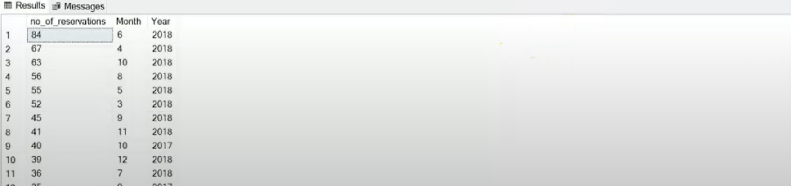
Query:
SELECT AVG(no_of_weekend_nights)
FROM hotel
WHERE no_of_children > 0;
Result: Average number of weekend nights for reservations involving children: 1
11 - What is the average number of weekend nights for reservations involving children?
Query:
SELECT COUNT(booking_id) as no_of_reservations , MONTH(arrival_date) as month ,
YEAR(arrival_date) as year
FROM hotel
GROUP BY year, month
ORDER BY no_of_reservations DESC;
12 - How many reservations were made in each month of the year?

Slide 10
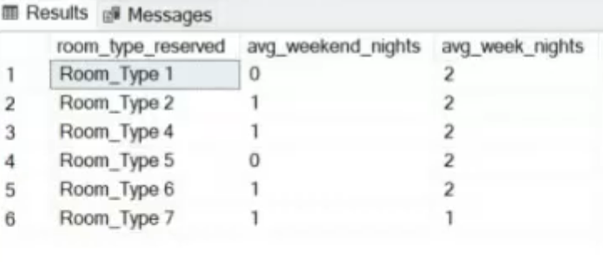
Query:
SELECT room_type_reserved, AVG(no_of_weekend_night) as avg_weekend_nights, AVG(no_of_week_night) as avg_week_nights
FROM hotel
GROUP BY room_type_reserved;
Result:
13 - What is the average number of nights (both weekend and weekday) spent by guests for each room type?
Query:
SELECT room_type_reserved, COUNT(room_type_reserved) AS times_reserved, AVG(avg_price_per_room) AS average_price_of_room
FROM hotel
WHERE no_of_children > 0
GROUP BY room_type_reserved ORDER BY counts DESC;
Result: The most common room type for reservations involving children is: 'Room_Type 1' with an average price of: $124
14 - For reservations involving children, what is the most common room type, and what is the average price for that room type?

Slide 11
Query:
SELECT market_segment_type, AVG(avg_price_per_room) AS average_price
FROM hotel
GROUP BY market_segment_type ORDER BY average_price DESC ;
Result: The market segment type that generates the highest average price per room is: Online, with an average price of: $112
15- Find the market segment type that generates the highest average price per room.

Slide 12
Summary and Recommendations:
Meal Plan 1 is favored by guests, indicating similar meal plans or meal deals could boost revenue and guest satisfaction.
A lead time of 443 days highlights the need for early booking promotions and long-term marketing strategies to increase occupancy rates.
The online market segment significantly contributes to room revenue, indicating opportunities for targeted marketing or partnerships with online booking platforms.

Slide 13
Month of April , May , June July , August , September has more number of reservations than other month .
Room Type 1 is popular, especially with families, suggesting improvements or promotions for this room type could attract more guests.
Improvements could include optimizing room pricing strategies, enhancing weekend stay packages, and offering tailored services for families to enhance guest satisfaction and attract more guests.
Rooms with children have a relatively high average price, suggesting potential for family-friendly packages or promotions to attract more bookings and revenue.

Slide 14
Thank You

